Slide 1

Machine Learning in
Oil and Gas
Chemical Engineering Capstone Project (CP302)
End-Semester Presentation
Date: 16 May, 2022
Presented By:
Mohamed Mazhar Laljee (2019CHB1051)
Project Mentor:
Dr. Asad H. Sahir

Slide 2
Introduction
Oil and gas contribute to 58% of the global energy mix.
Meticulous, cost effective and environmentally benign operations necessary.
Making predictions is essential for economic evaluation and process optimization.
Analytical methods are too simple.
Numerical methods are too tedious and complex.
Machine Learning helps strike a middle ground.

Slide 3
Problem Scope
Objectives
Rationale
Build a continuous-learning model to predict the rate of penetration (ROP) on-the-go
Time is crucial while drilling wells, drilling rate optimization requires a prediction model
1
Develop a sonic log prediction model for deployment in new wells
Sonic well logs are important to better understand the formation
2
Use neural networks to forecast production days in advance
Production forecasting is essential for managing operations
3

Slide 4
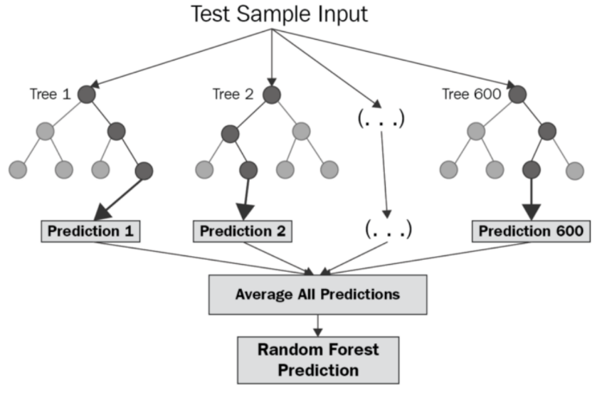
ML Algorithms
Random Forest Regression:
Builds ‘n’ decision trees
Each tree trains on a random subset of features and samples
Model prediction is average of tree predictions
High accuracy, no feature scaling, easy to use
Fig. 1: Random Forest Algorithm
Source: (3)

Slide 5
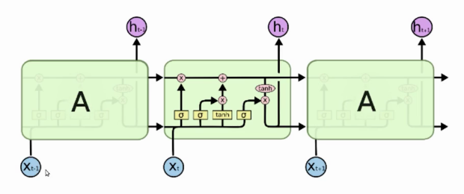
ML Algorithms
Long Short-Term Memory (LSTM):
Stores past information to factor in while making predictions
Has three ‘gates’: forget, input and output
Advancement of Recurrent Neural Networks (RNNs)
Fig. 2: LSTM Schematic
Source: (4)

Slide 6
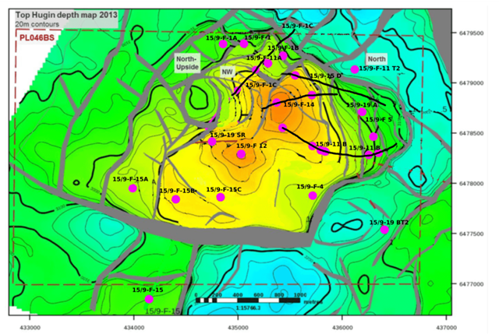
Volve Dataset
Released by Equinor in May 2018
40,000 file repository
2 x 3 km offshore sandstone reservoir
Depth: 2750-3210 m below see level
Porosity = 0.21, permeability = 1000 mD, net-to-gross ratio = 0.93
Reservoir pressure = 340 bar, temperature = 110 ºC at 3060 m
63,000,000 barrels of oil produced
Fig. 3: Contour Map of Volve Oilfield
Source: (7)

Slide 7
Feature Selection
ROP Model:
Feature | Effect on ROP
Measured Depth | Decreases with increase in depth
Weight on Bit (WOB) | Increases with increase in WOB up to a critical value, then decreases
Average Standpipe Pressure | Increases with increase in standpipe pressure
Average Surface Torque | Increases with increase in surface torque up to a critical value, then decreases
Average Rotary Speed | Increases with increase in rotary speed up to a critical value, then decreases
Mud Flow In | Increases with increase in flow rate
Mud Density In | Increases with decrease in density
Average Hookload | Increases with increase in hook load up to a critical value, then decreases
Gamma Ray | Lithology dependent
Table 1: ROP Model Selected Features

Slide 8
Feature Selection
Sonic Log Model:
Formation Feature | Effect on Sonic Wave Travel Times
Porosity | Increase with increase in porosity
Bulk Density | Decrease with increase in density
Gamma Ray | Increase with increase in gamma
True Resistivity | Decrease with increase in resistivity
Photelectric Absorption Factor (PEF) | Decrease with increase in PEF
Table 2: Sonic Log Model Selected Features

Slide 9
Feature Selection
Production Forecasting Model:
Feature | Effect on Production
Days | Decreases with each passing day
On Stream Hours | Increases with increase in number of hours
Average Downhole Pressure | Increases with increase in downhole pressure
Average Downhole Temperature | Could influence oil-gas proportion
Average Choke Size Percentage | Increases with choke size opening
Average Wellhead Pressure | Decreases with increase in wellhead pressure
Average Wellhead Temperature | Could influence oil-gas proportion
Oil Volume from Well | Historical perspective
Gas Volume from Well | Historical perspective
Water Volume from Well | Historical perspective
Table 3: Production Forecasting Model Selected Features

Slide 10
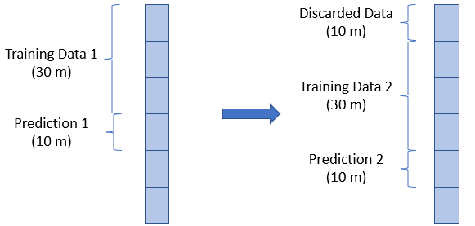
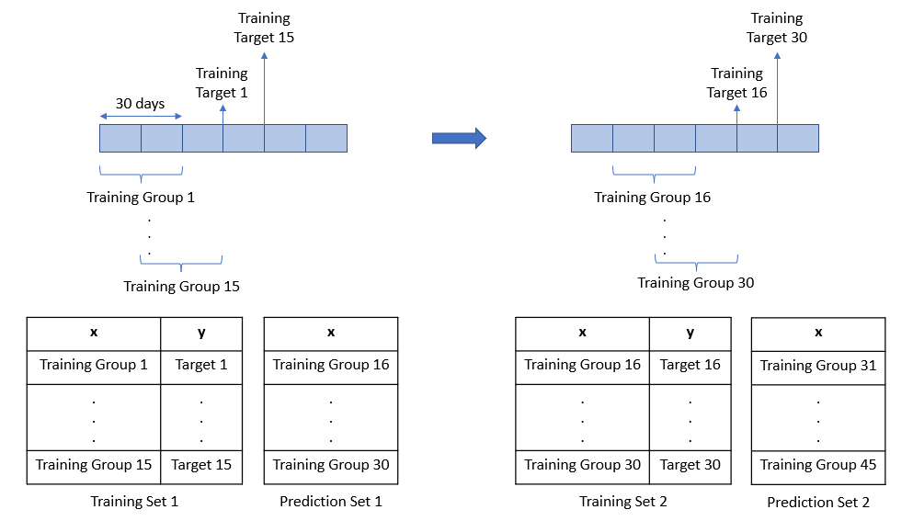
Model Workflows
Fig. 5: Production Forecasting Model Workflow
Fig. 4: ROP Prediction Model Workflow
Sonic Log Prediction- Distinct training and validation datasets

Slide 11
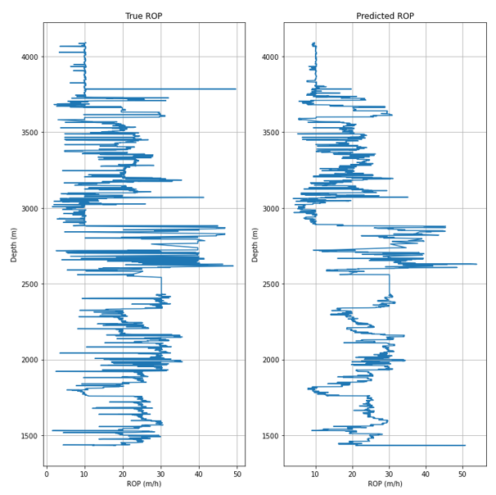
Results- ROP Prediction
R² = 0.683
MAPE = 20.7%
Trend effectively captured
Abrupt variations explainable by domain experts
More data and deep learning can augment performance
Fig. 6: Actual and Predicted ROP vs Depth

Slide 12
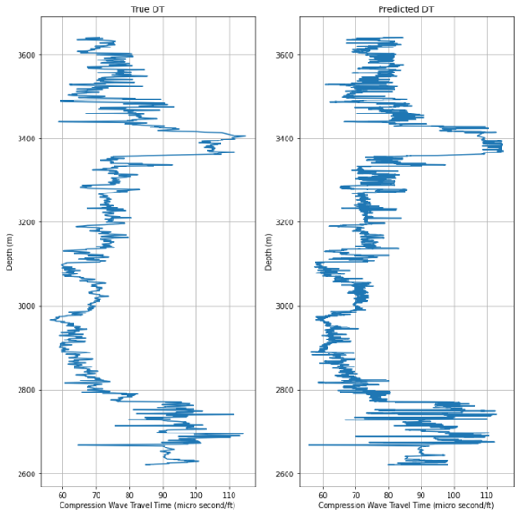
Results- Sonic Log Prediction
Compression Wave Travel Time (DT):
Training data R² = 0.998
Blind data R² = 0.85
Blind data MAPE = 3.92%
Predictions close to real deal
Predictions used for shear wave travel time modelling
Fig. 7: Actual and Predicted DT vs Depth

Slide 13
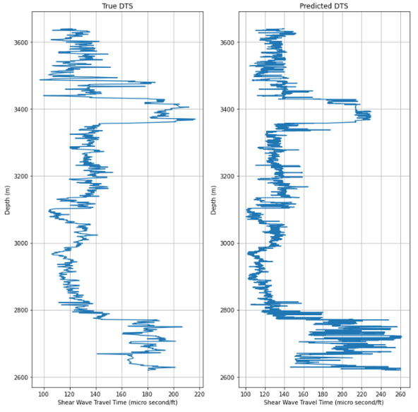
Results- Sonic Log Prediction
Shear Wave Travel Time (DTS):
Training data R² = 0.998
Blind data R² = 0.54
Blind data MAPE = 6.43%
Good predictions except at lower depths
Scope for improvement exists
Fig. 8: Actual and Predicted DTS vs Depth

Slide 14
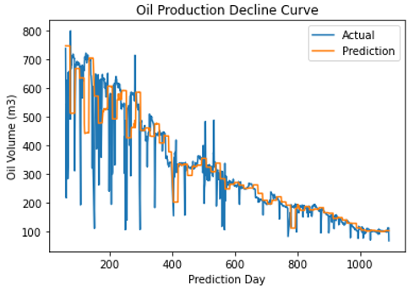
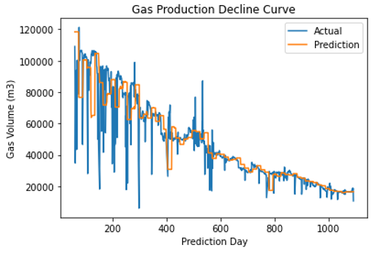
Results- Production Forecasting
Fig. 9: Comparison of Actual Oil Production and Forecasts
Fig. 10: Comparison of Actual Gas Production and Forecasts
Oil:
R² = 0.79
MAPE = 14.75%
Gas:
R² = 0.76
MAPE = 15.5%

Slide 15
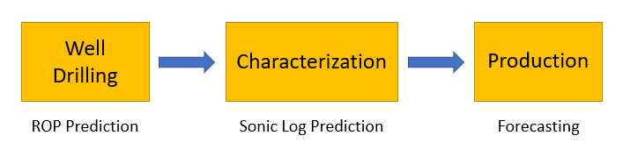
Conclusions
End-to-end workflow developed
R² for models ranges from 0.54 to 0.85, and MAPE ranges from 3.92 to 20.7%
Suggested ways to improve model performance
Understood challenges of working with real-world big data
Gained an understanding of ML and its impact on core engineering industries
Satisfactory results obtained for a student project and objectives achieved
Fig. 11: End-to-End ML Workflow

Slide 16
Future Scope
Using combinations of algorithms to solve problems
Optimization of target variables with the help of models developed
Identifying exciting problems related to well completion, hydraulic fracturing, etc.
Parsing of data to make it more accessible
Incorporating data from other oilfields
Industry collaboration

Slide 17
References
Fan, D.; Sun, H.; Yao, J.; Zhang, K.; Yan, X.; Sun, Z. Well production forecasting based on ARIMA-LSTM model considering manual operations. Energy. 2021, 220, 1. DOI: 10.1016/j.energy.2020.119708 (accessed 2022-4-7)
Elkatatny, S. Real-time prediction of rate of penetration while drilling complex lithologies using artificial intelligence techniques. Ain Shams Engineering Journal. 2021, 12(1), 917. DOI: 10.1016/j.asej.2020.05.014 (accessed 2022-4-7)
The Ultimate Guide to Random Forest Regression. Keboola, September 17, 2020. https://www.keboola.com/blog/random-forest-regression (accessed 2022-4-11)
Saxena, S. Introduction to Long Short Term Memory (LSTM). Analytics Vidhya, March 16, 2021. https://www.analyticsvidhya.com/blog/2021/03/introduction-to-long-short-term-memory-lstm/ (accessed 2022-4-11)
Volve field data set. Equinor. https://www.equinor.com/energy/volve-data-sharing (accessed 2022-3-10)
Ng, C.S.W.; Ghahfarokhi, A.J.; Amar, M.N. Well production forecast in Volve field: Application of rigorous machine learning techniques and metaheuristic algorithm. Journal of Petroleum Science and Engineering. 2022, 208 Part B, 1-8. DOI: 10.1016/j.petrol.2021.109468 (accessed 2022-4-8)
Ankit. Geological Cross Sections for the Volve Oilfield. DiscoverVolve, March 25, 2022. https://discovervolve.com/2022/03/25/geological-cross-sections-for-the-volve-oilfield/ (accessed 2022-4-13)

Slide 18

THANK YOU!

